Slide 1
Exploratory Data Analysis of Healthcare Dataset
Week 11 Deliverable
Atshaya Srinivasan
atshayarakshanaa@gmail.com

Slide 2
Introduction
Objective:
To analyze the healthcare dataset to gain insights and prepare it for modeling.
Dataset Description:
The dataset contains 3424 entries and 69 columns, with a mix of numerical and categorical variables.

Slide 3
Data Loading and Initial Exploration
Data was loaded from an Excel file.
Initial check for missing values.

Slide 4
Missing Values Analysis
Description:
Checked for missing values.
Result: No missing values in the dataset.

Slide 5
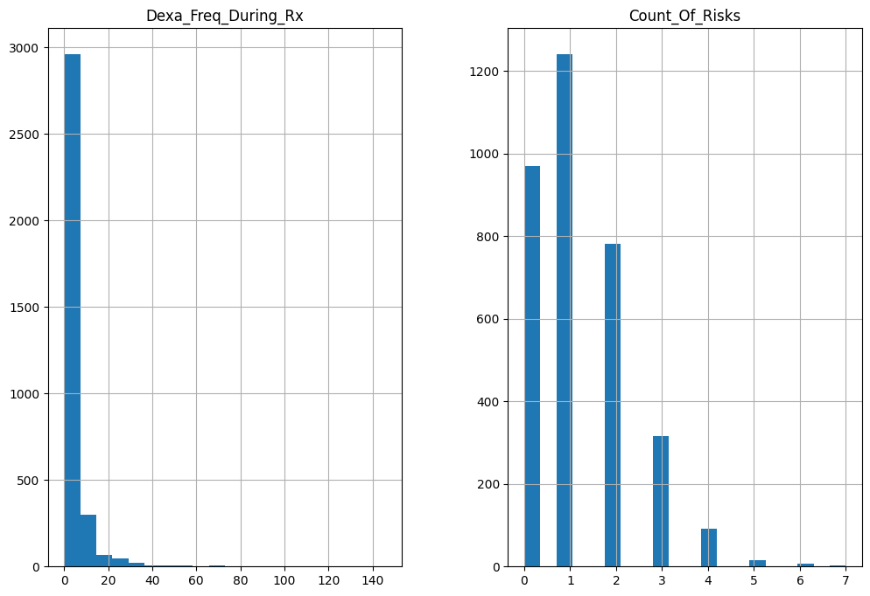
Data Distribution
Histograms to check the distribution of numerical features.

Slide 6
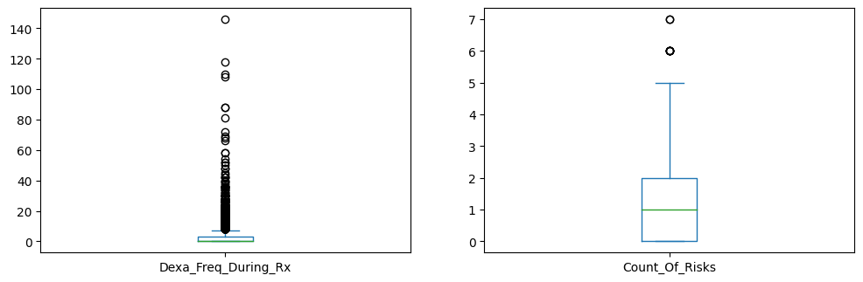
Outlier Detection
Box plots to identify outliers.

Slide 7
Handling Outliers
Calculation of Z-scores to handle outliers. Based on the result, we conclude that Data points with Z-scores beyond a threshold of 3 were removed, reducing the dataset size to 3344 entries.

Slide 8
Skewness in data
Skewed data in numerical columns (Dexa_Freq_During_Rx and Count_Of_Risks) were transformed using log transformation to reduce skewness and normalize the distribution.

Slide 9
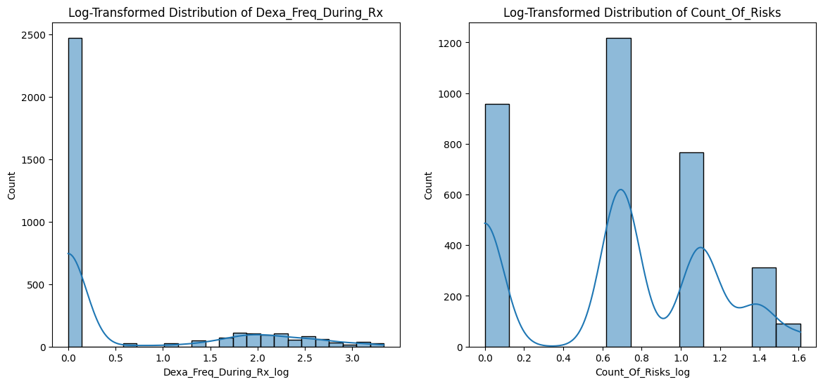

Slide 10
Categorical Features Analysis
Analysis of categorical features using bar charts.
Based on the above result,
The gender chart shows a clear imbalance. There are far more females than males in the dataset. This suggests a gender bias in the data.
There's a strong bias towards Caucasians, who make up the vast majority of the dataset. Other races (Asian, African American, Other/Unknown) are significantly underrepresented. This indicates racial bias in the data.
The ethnicity chart shows a heavy bias towards "Not Hispanic" individuals. Hispanic and Unknown categories are very small in comparison. This suggests an ethnic bias in the data.

Slide 11
...continue
There's a strong imbalance favoring "Adherent" over "Non-Adherent". This suggests bias in the adherence data.
The consistent pattern might indicate a selection bias in the study population or data collection process.
Risk Type 1 Insulin Dependent Diabetes, Risk untreated chronic hypogonadism, Risk Patient Parent Fractured their hip are being heavily skewed towards 'N'. And the distribution seems reasonable and doesn't indicate obvious bias.
Risk_Chronic_Liver_disease chart could potentially indicate bias or error, as it's unusual to have zero cases in the large dataset.
Risk_Low_calcium_Intake could indicate potential bias or measurements issues, as low calcium intake is generally more common.
From the result, some of the charts shows the extreme skewness and these indicates data collection bias, sampling bias, measurement errors

Slide 12
Feature Interaction Analysis
The correlation matrix was calculated to identify relationships between the target variable and the feature variables.
Univariate and Bivariate Analysis is done using
Histogram and count plots to visualize the distribution of numerical and categorical features
Box plots and count plots by Persistency_Flag were used to explore relationships between features and the target variable.

Slide 13
Recommended Models for Predictive Analysis
Summary of recommended models based on EDA findings.
Models:
- Random Forest Classifier
- Logistic Regression
- Gradient Boosting Classifier
- Support Vector Machine (SVM)

Slide 14
Model Recommendations for Technical Users
Recommended Models for the Healthcare Dataset:
1. Random Forest Classifier
- Handles high-dimensional data well, robust to outliers, and provides feature importance.
- Preprocessing: Minimal preprocessing required; handle categorical variables using one-hot encoding.
2. Logistic Regression
-Simple to implement, interpretable, and performs well with binary outcomes.
- Preprocessing: Scale numerical features, encode categorical variables.

Slide 15
3. Gradient Boosting Classifier
- Effective for binary classification, handles missing data well, and provides high predictive accuracy.
-Preprocessing: Handle categorical variables, impute missing values.
4. Support Vector Machine (SVM)
- Effective in high-dimensional spaces and with clear margin separation.
- Preprocessing:Scale numerical features, encode categorical variables.
These models provide a robust starting point for building a predictive system for the given healthcare dataset. Fine-tuning these models through hyperparameter optimization and cross-validation is recommended for achieving the best performance.

Slide 16
Conclusion
Features like Count_Of_Risks, Risk_Chronic_Liver_Disease_Yes, and Risk_Poor_Health_Frailty_Yes are highly positively correlated with the target variable and could be critical for predictive modeling.
Features like Dexa_Freq_During_Rx_Log, Risk_Vitamin_D_Insufficiency_Yes, and Risk_Low_Calcium_Intake_Yes are negatively correlated with the target variable and also provide valuable information.
Next Steps: Implementation of the recommended models and further tuning.

